Slide 1


Wearable devices for ECG as an accessible way for Subject Identification using Deep Learning tecniques
Laddomada Pietro
Piva Francesco
2010564
2038151
Human Data Analytics, a.y. 2022/2023, University of Padua

Slide 2

Introduction
BIOMETRICS 🡪 originally Greek term meaning «measurement of life»
In cybersecurity, biometrics refers to authentication tecniques that use distinctive anatomical and behavioral human characteristics, called biometric identifiers or traits, for automatically recognizing individuals.
Some of the most use biometric identifiers are:
fingerprint;
face;
retinal structure;
voice;
…

Slide 3
Introduction
Characteristics:
Tamper-proof;
Timeless;
Unique.

Slide 4

Introduction
Characteristics:
Tamper-proof
Timeless
Unique
Why ECG?

Slide 5

Introduction
Why ECG?
Higly Subject-dependent;
Easy to collect (e.g. Wearable devices);
DNN architectures can provide an accurate ECG discrimination based on individual unique features.

Slide 6

Goal of this work
Biometric Identification with ECG Signal: The goal of this work is to confirm that ECG signal acquired thorugh Wearable devices can be use as biometrics identifiers.
Different kind of Data-set for more generalization
Implementation of Pre-processing techniques
Various Deep Learning architectures for Subject-Identification

Slide 7



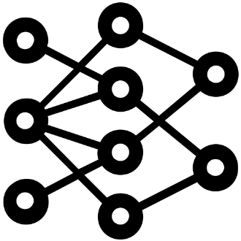

Methods
1) Dataset:
15 subjects
Rest Dataset
Task Dataset
3) Train – Validation - Test
Classes equally balanced
Train 60%
Validation 15%
Test 25%
2) Pre-Processing
Interpolation & Data Filtering
Segmentation and Cleaning
Merging Segments
2D Spectrogram
4) Neural Network:
Fully-Connected Dense NN
Recurrent NN
2D Convolutional NN (Rest)
Training
Metrics & Evaluation
Networks comparison

Slide 8
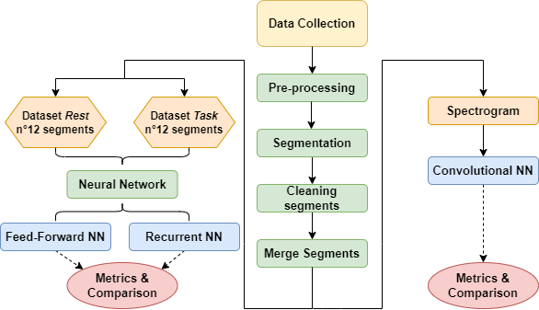
Processing pipeline

Slide 9
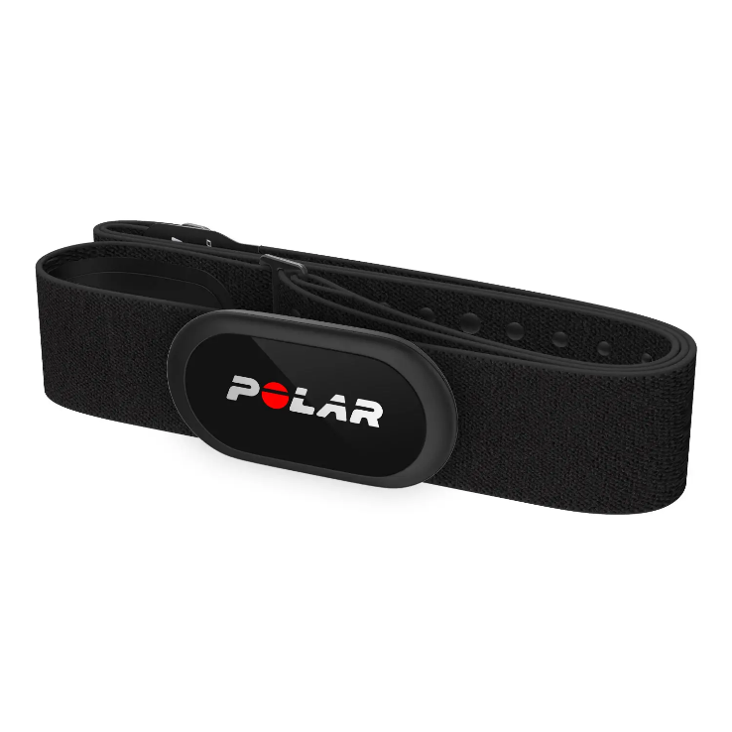




Dataset collection
!
Wearable Polar H10:
Chest Band for ECG acquisition
Data acquired via Bluethooth through Android App
Dataset:
15 Subjects (+2 failed acquisition)
Age 23 ± 3
8 men 7 women
No past history of cardiovascular diseases
Pay Attention: the band must firmly adhere to the chest in order to avoid artifacts.

Slide 10
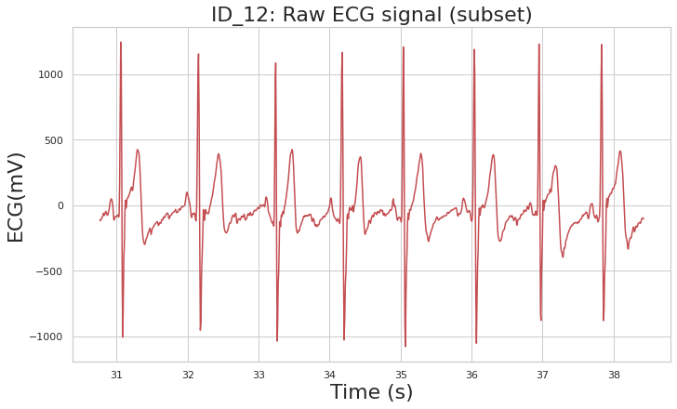

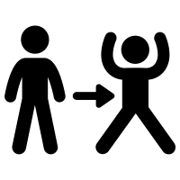
Dataset
!
Rest Dataset
Acquisition time ≥120 s
Subject in seated position
Task Dataset
Acquisition time ≥150 s
~60 s seated position
~30 s Jumping Jacks task
~60 s post task
Subject ID_12; example portion of Raw ECG

Slide 11

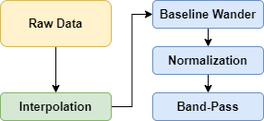
Pre-processing: Interpolation
!
Different fs : the sample frequency changes among subjects and between rest and task dataset for the same subject
Linear Interpolation
Non-uniform time axis: for the same subject, the fs changes during the data collection, generating different Δt between contiguos samples
!
Pre-processing pipeline

Slide 12
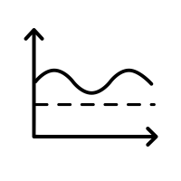
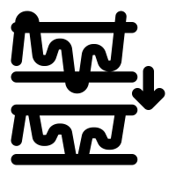
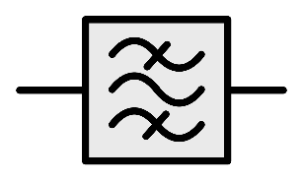
Pre-processing: baseline wander, normalization & band-pass filtering
!
1) Baseline wander removal: n°2 median filters to remove non-releated ECG low frequencies such as:
Breathing
Movement artifacts
2) Normalization: amplitude normalization allows to compare all ECG signals.
3) Feed-forward Band-pass filtering: to remove undesired frequencies non releated to ECG. Cut-off 0.667 – 65 Hz, order 8

Slide 13


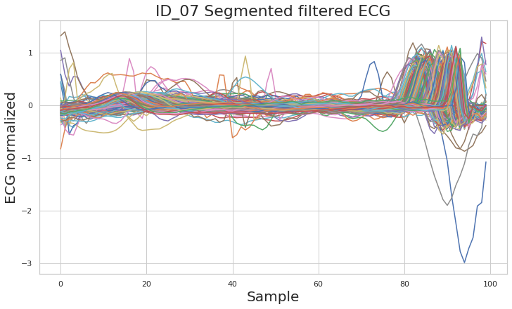
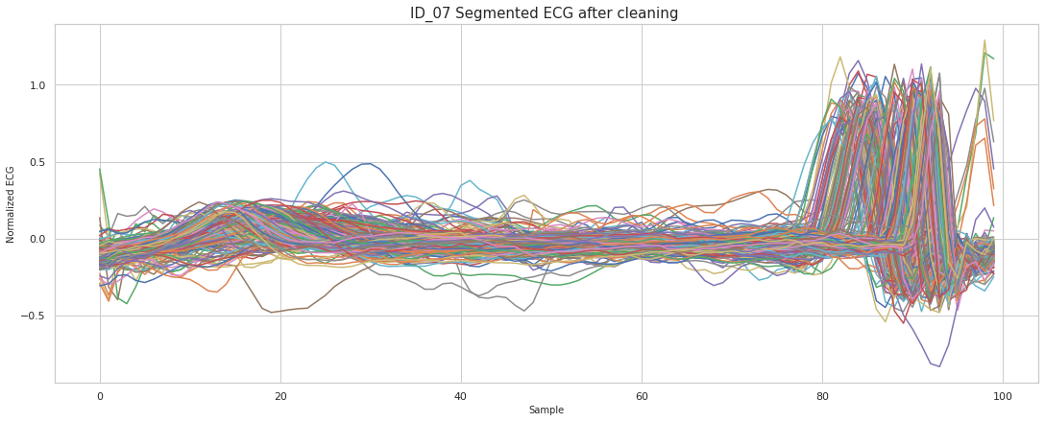
ECG segmentation & cleaning
!
Segmentation Algorithm:
Peak recognition
Segmentation
Re-sampling, length 100
Cleaning Segments:
Interval [0:79] samples:
Normalized value <0,3
Interval [80:99] samples:
Normalized value <1,3

Slide 14
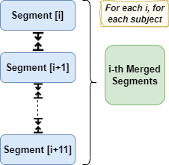

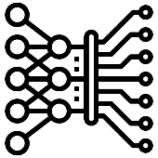
ECG Merging Segments
!
Merging Segments
Starting from i-th segments
Concatenating the following 11 segments
Average Moving Window to remedy discontinuities caused by the Cleaning process
ECG trace made by 12 segments
Starting from [i+1]th
Repeat 2-5…
Concatenation pipeline
Each resulting concatenation will be the input of the FFNN and RNN

Slide 15
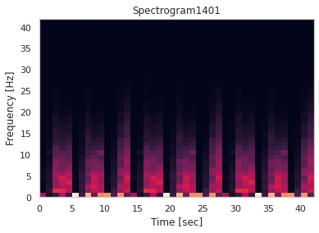
ECG Spectrogram for 2D CNN
!
Spectrogram: applied for each ECG trace from the Rest dataset
Spectrogram with Tukey window (dimension=100, alpha=0.2, overlap=20)
Replicate the spectrum to create a squared-imaged of dimension (42,42)
Spectrum dataset will be the input of the 2D Convolutional NN

Slide 16

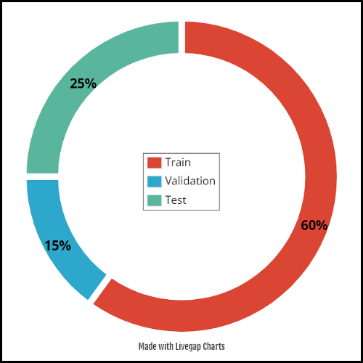
Train – Validation - Test
Each classes has Unbalanced occurence, beacuse of different acquisition time, segmentation and cleaning process.
Splitting Data-set: Rest, Task & Spectrogram dataset were splitted in Train-Validation-Test, balancing the classes percentage in each of them.

Slide 17
Neural networks implemented
Fully-connected NN (or dense NN): as basic architecture;
Recurrent NN: in order to capture the temporal evolution of the ECG signals;
Convolutional NN (2D): in order to provide an alternative to 1D signals.

Slide 18
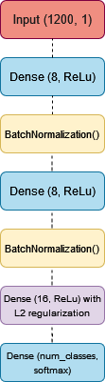
Fully-connected NN
!

Slide 19


Fully-connected NN
!
Training
Epochs: 40
Batch Size : 32
Optimizer: Adam Optimizer, Learning rate = 1e-3
Loss Function : Categorical Cross-Entropy
Weighted Metric : Accuracy
Stopping Criteria:
Validation Loss
Patience = 5 epochs

Slide 20
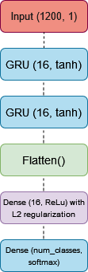
Recurrent NN
!

Slide 21
Recurrent NN
!
Training
Epochs: 40
Batch Size : 32
Optimizer: Adam Optimizer, Learning rate = 5e-4
Loss Function : Categorical Cross-Entropy
Weighted Metric : Accuracy
Stopping Criteria:
Validation Loss
Patience = 5 epochs

Slide 22
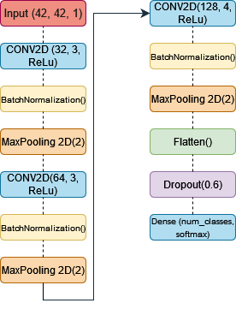
2D Convolutional NN
!

Slide 23
2D Convolutional NN
!
Training
Epochs: 60
Batch Size : 8
Optimizer: SGD, Learning rate = 1e-4, Momentum = 0.01
Loss Function : Categorical Cross-Entropy
Weighted Metric : Accuracy
Stopping Criteria:
Validation Loss
Patience = 8 epochs

Slide 24
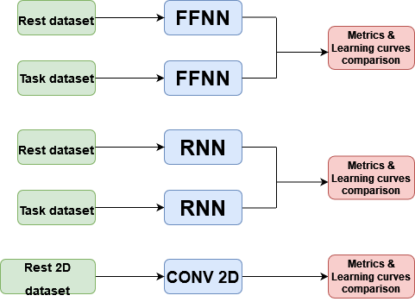
Results: pipeline of discussed results
1.
2.
3.

Slide 25
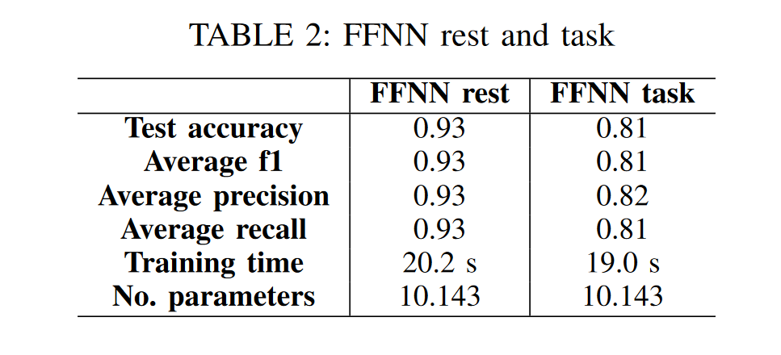
Results: fully-connected NN
1.
!
FFNN metrics
very good performance in the rest dataset;
lower performance in the task dataset;
good training time;
Very low n° of parameters

Slide 26
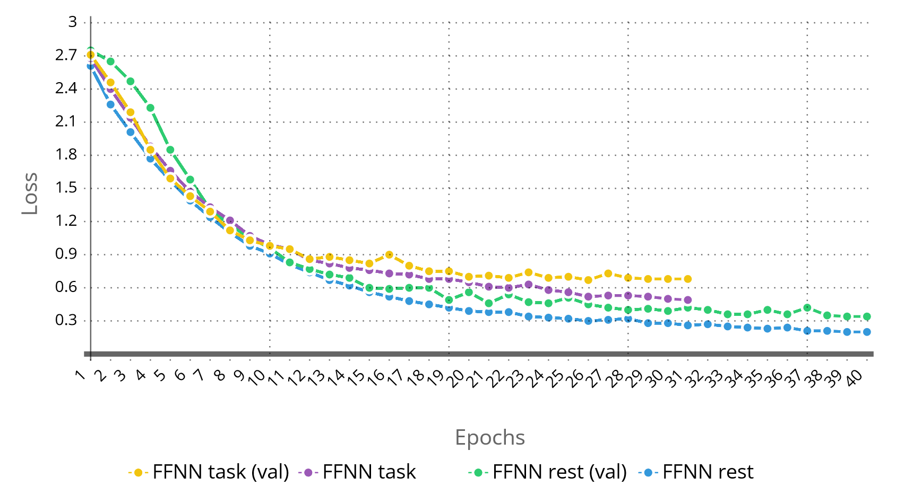
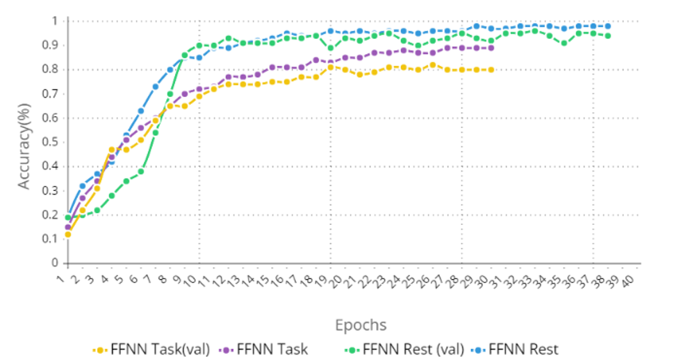
Results: fully-connected NN
1.
!
FFNN learning curves
No overfitting, good learning curves

Slide 27
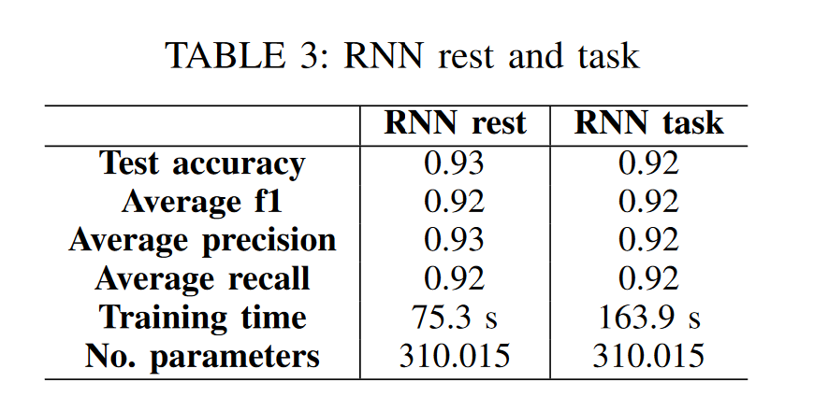
Results: Recurrent NN
2.
!
RNN metrics
very good performance in both dataset;
Higher training time, especially in the task dataset;
Higher n° of parameters

Slide 28
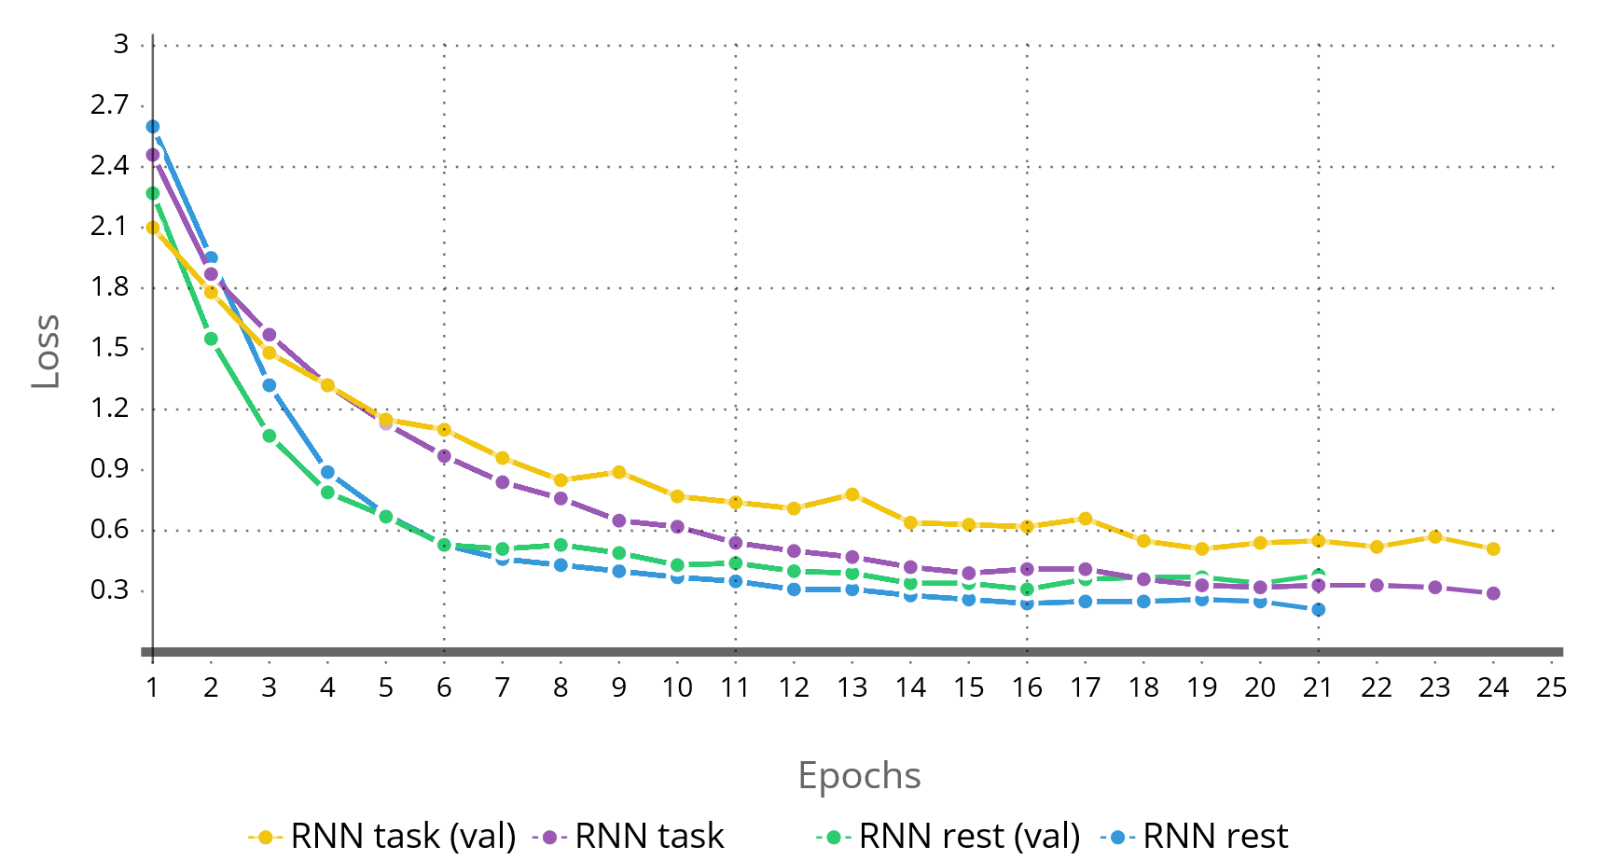
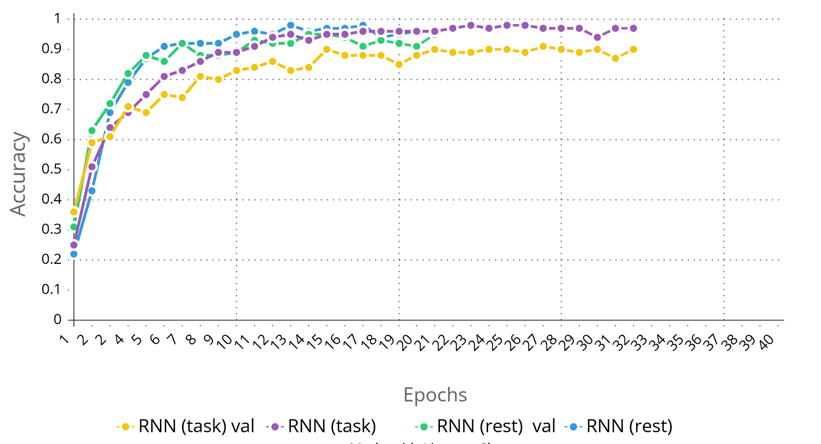
Results: Recurrent NN
2.
!
RNN learning curves
No overfitting, good learning curves

Slide 29
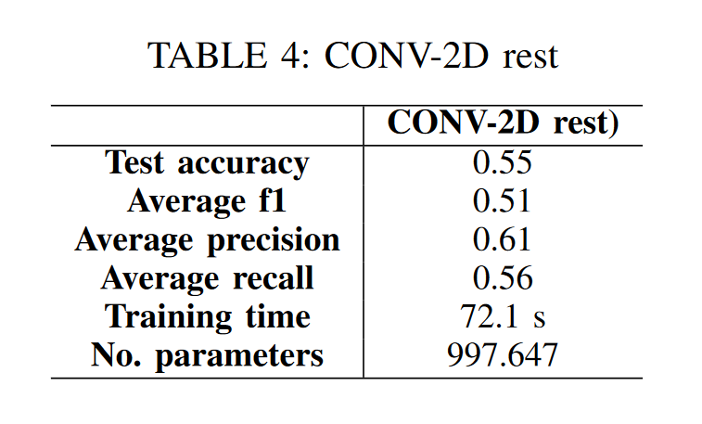
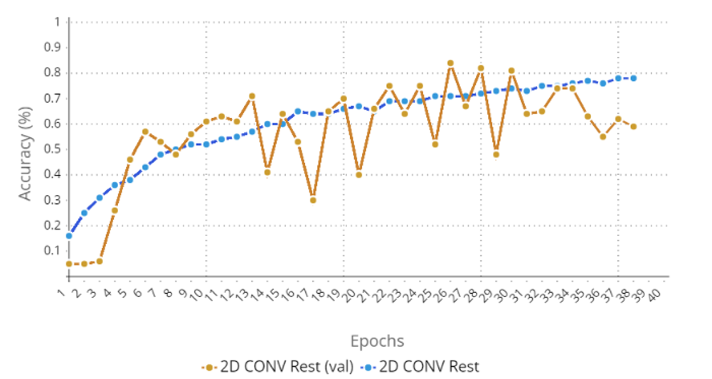
Results: 2D Conv NN
3.
!
(
No sufficient performance in the rest data-set
Higher training time;
Higher n° of parameters
Problem on Accuracy Validation set

Slide 30
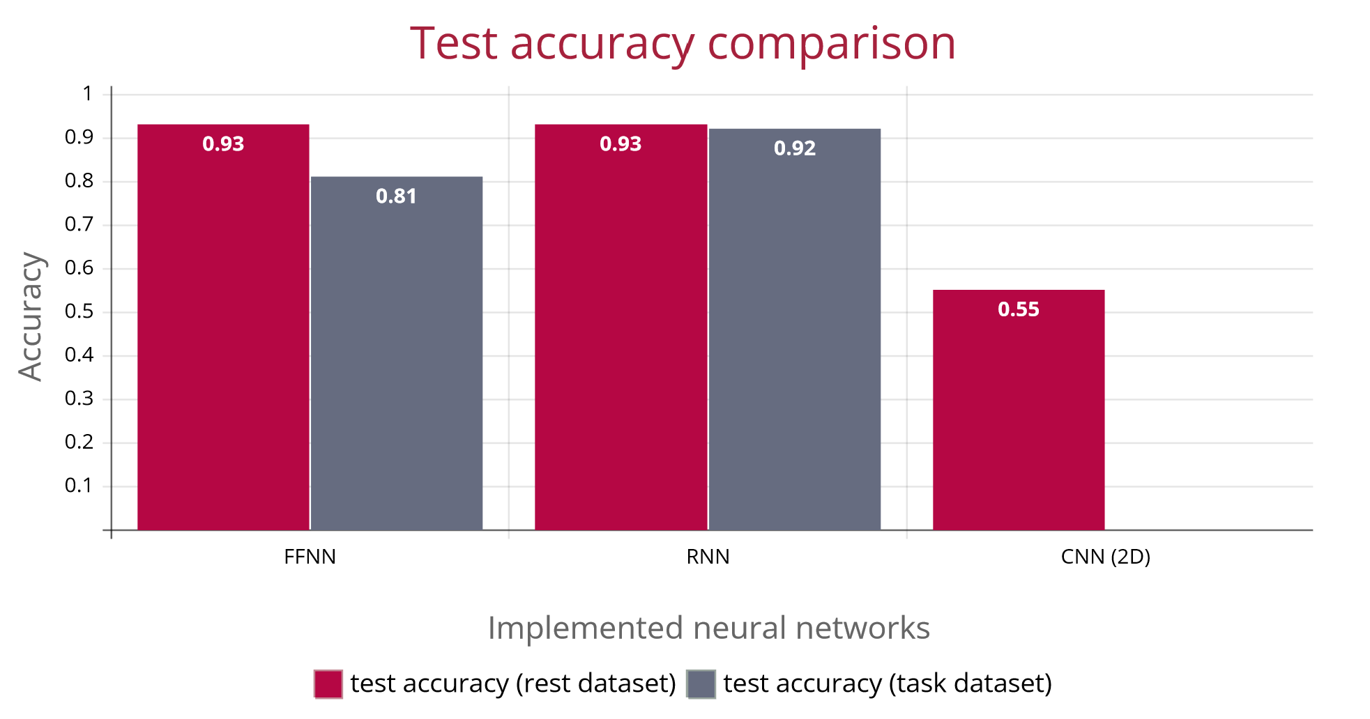
Networks comparison: Test accuracy

Slide 31
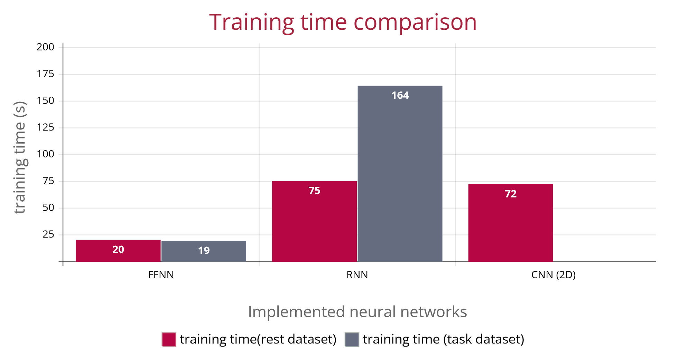
Networks comparison: training time

Slide 32
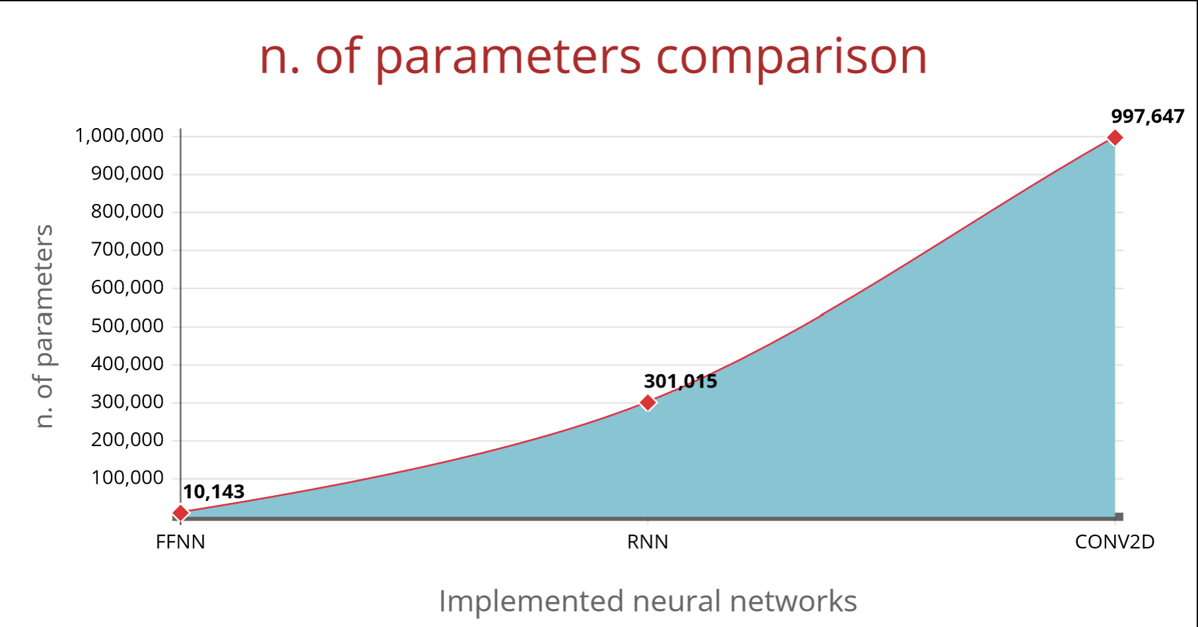
Networks comparison: n. of parameters

Slide 33

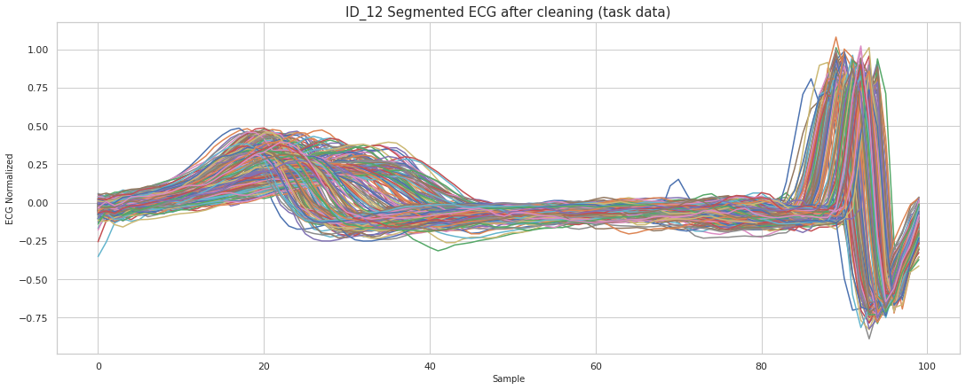
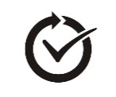


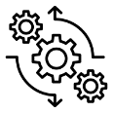

DEMO: a new dataset
Dataset
Classes = 2 two authors of this work;
Completely independent rest and task data
have been acquired;
New task for one subject!
All the pre-processing tecniques
have been implemented;
Spectrograms have not been considered.

Slide 34
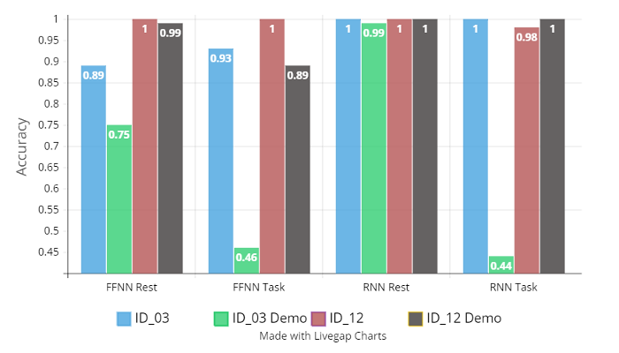
DEMO: Results
New task for ID_03
Rest Dataset
Demo accuracy results coherent with previous train set
Task Dataset
Very low accuracy for ID_03, which made a different task (Skip);
Demo accuracy results coherent only with ID_12 which made the same task (Jumping Jacks).

Slide 35

Conclusions
The Fully-Connected NN is the simplest architecture implemented in this work, and so the most easy to adapt on a smartphone. The compromise is a lower performance in dynamic activity
The Recurrent Neural Network is slightly more complex with higher training time and n. of parameters. Higher performance for dynamic activity.
The 2D Convolutional NN does not offer good performance, and need more investigation;

Slide 36


Conclusions
Fully-Connected NN
simplest architecture implemented
the most easy to adapt on wearable.
The compromise is a lower performance in dynamic activity
Recurrent Neural Network
slightly more complex with higher training time and n. of parameters;
Higher performance for dynamic activity.
2D Convolutional NN
New usage of ECG in a different domain;
not offer good performance;
needs more investigation.

Slide 37
Conclusions
Demo with New Dataset
Coherent permormance for the rest dataset.
The network performance is depentent on the task.
Wearable measure variability
Permormance dependent on data acquisition (n°2 subjects excluded)
Wearable & Neural Network for Subject Identification
Satisfactory performance for the rest dataset
Task dependecies, but promising performance for RNN
Spctrogram & 2D Conv NN requires more investigation

Slide 38

Future works
Improve Replicability of the experiment and Robustness of the model, through multiple session acquisition and different tasks, to «overcome» biological and measurement variability, to improve generalization of the models
Investigating about how networks behave adding more classes;
Multimodal approach by using other wearables, such as Pulse Oxymeter for PPG signal;
Evaluating advanced architectures to obtain better performance (cumbersome with wearable), as was done for the 2D Convolutional NN.
More investigation on Spectrum dataset and the relative 2D network.
Take advantage of the chest band during competitive sports for prevention and diagnosis.

Slide 39
THANKS FOR YOUR ATTENTION
ANY QUESTIONS ?
Laddomada Pietro
Piva Francesco
2010564
2038151
Human Data Analytics, a.y. 2022/2023, University of Padua

